Slide 1

Network Coding with Correlated Sources, and Some Results on The General Broadcast Channel
Amin Aminzadeh Gohari
Presenting joint work with
Dr. Yang Prof. Nair
Prof. Jaggi Yanlin
Prof. Yeung Yuanming
Institute of Network Coding, Chinese University of Hong Kong

Slide 2
Outline
A converse for Network Coding with correlated sources
Motivation
Discussing the new technique
General broadcast channels (very intuitive discussion)
/27
Notes:
Insert a map of your country.

Slide 3
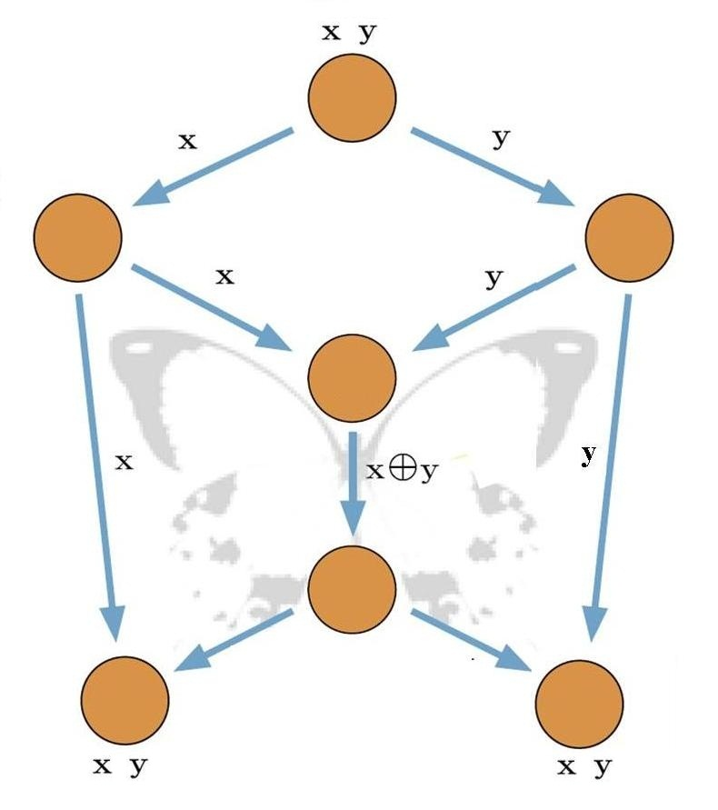
Motivation
/27
Notes:
Two sequence of binary bits.

Slide 4
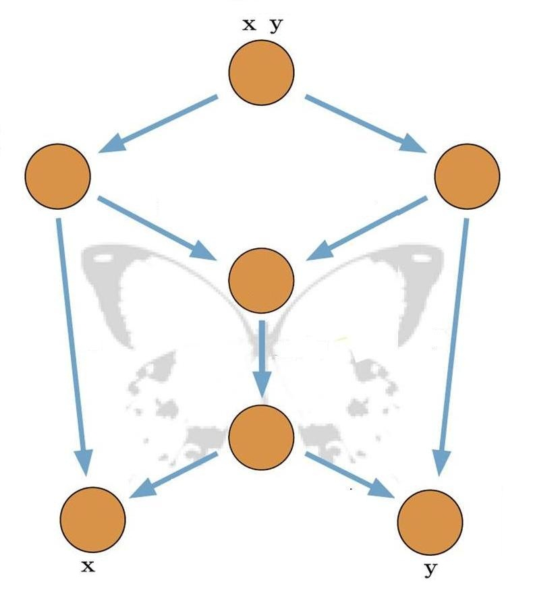
Motivation
/27
Notes:
Two sequence of binary bits. But one sink is interested in x, and the other in y.

Slide 5

Motivation
/27
Notes:
Now, let us that the sequences are generated by a process.

Slide 6
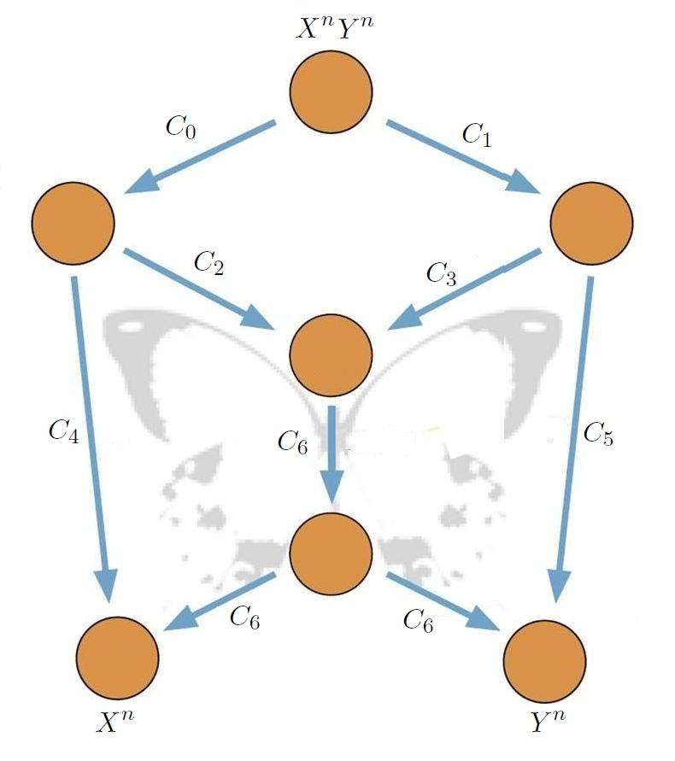
Motivation
/27
Notes:
Insert a map of your country.

Slide 7
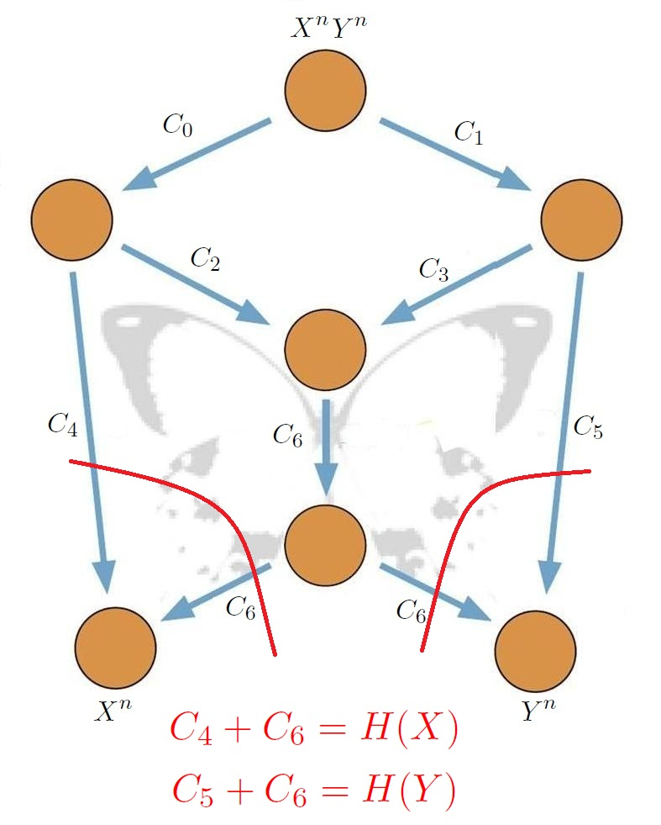
Motivation
/27
Notes:
Insert a map of your country.

Slide 8
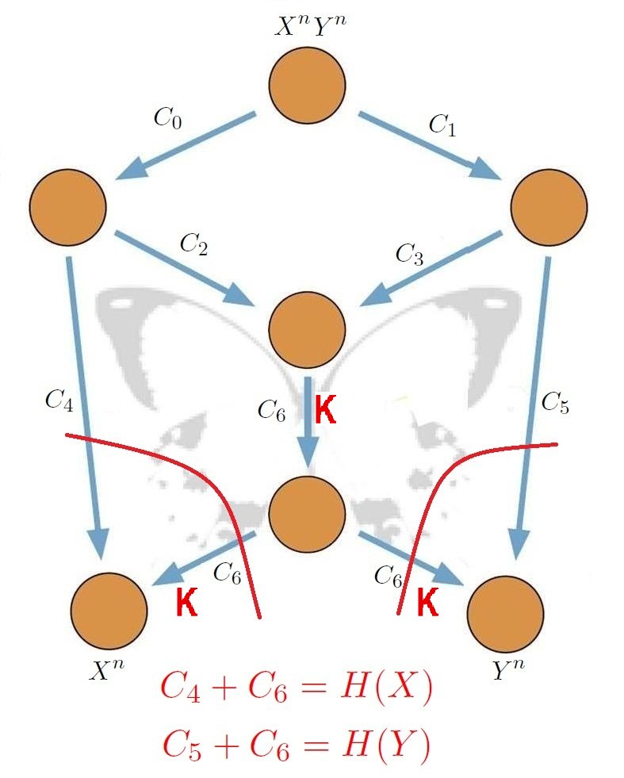
Motivation
/27
Notes:
Insert a map of your country.

Slide 9
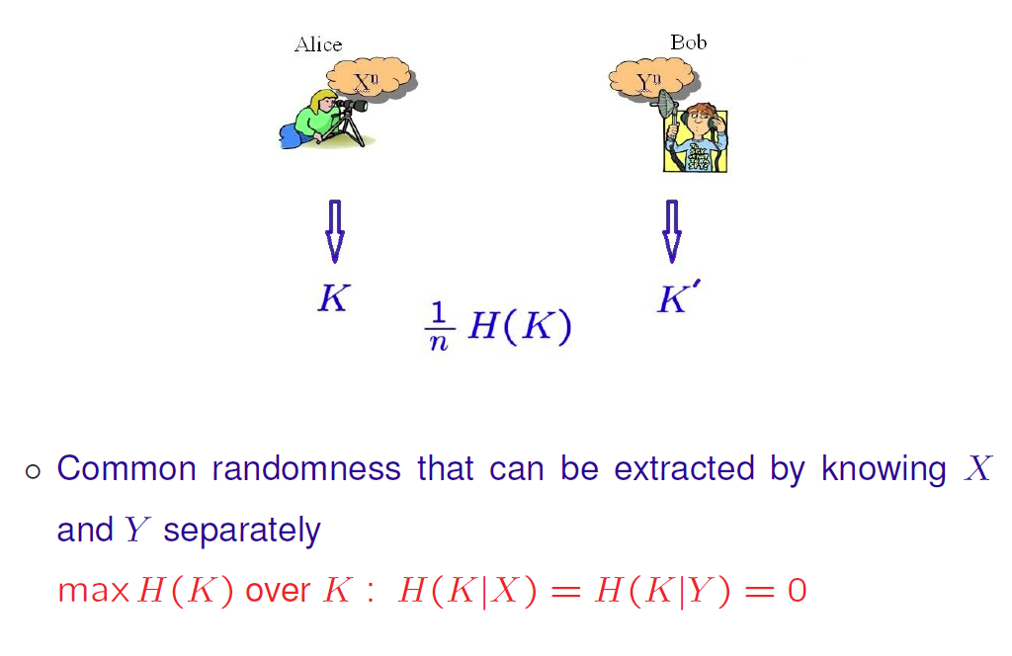
Motivation
/27
Notes:
Insert a map of your country.

Slide 10
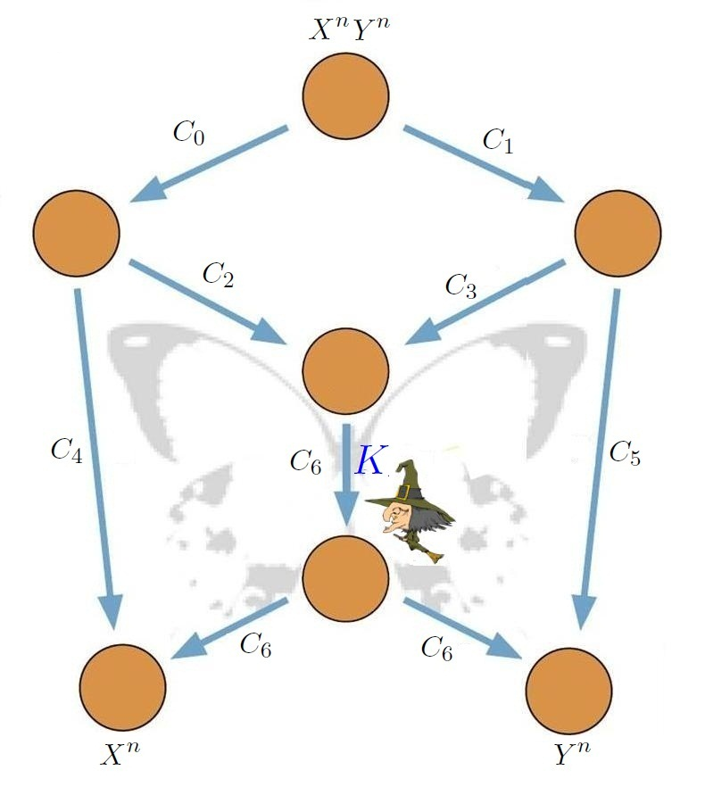
Motivation
/27
Notes:
Insert a map of your country.

Slide 11
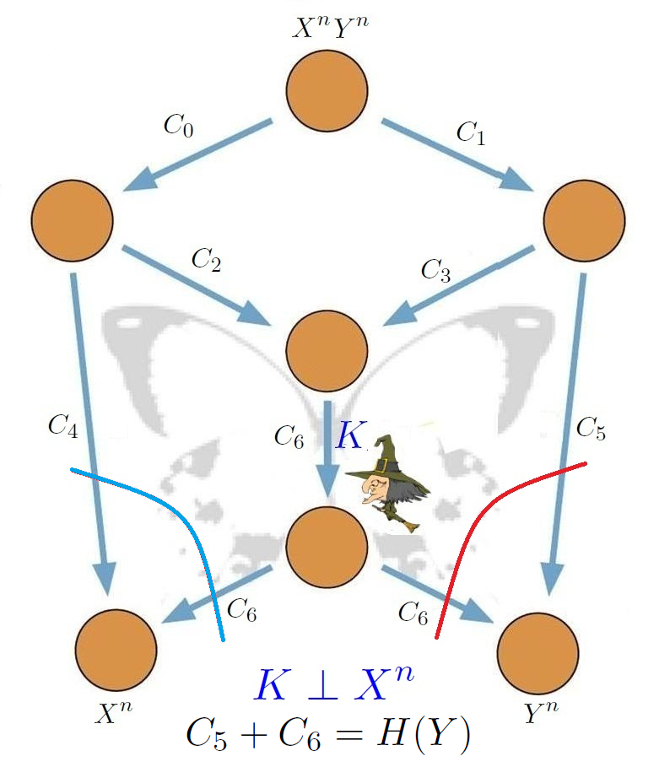
Motivation
/27
Notes:
Insert a map of your country.

Slide 12
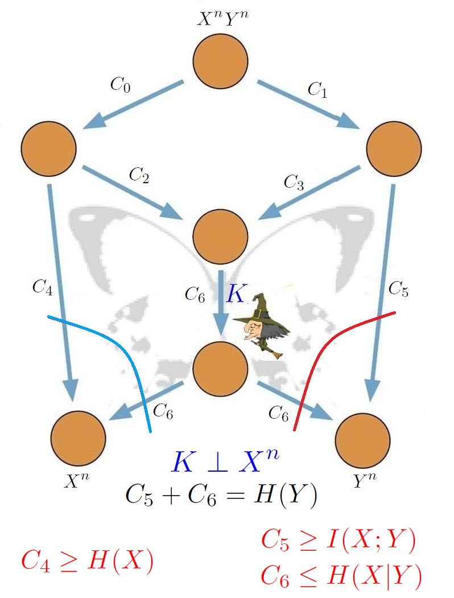
Motivation
/27
Notes:
Insert a map of your country.

Slide 13
Outline
A converse for Network Coding with correlated sources
Motivation
Discussing the new technique
General broadcast channels
/27
Notes:
Insert a map of your country.

Slide 14
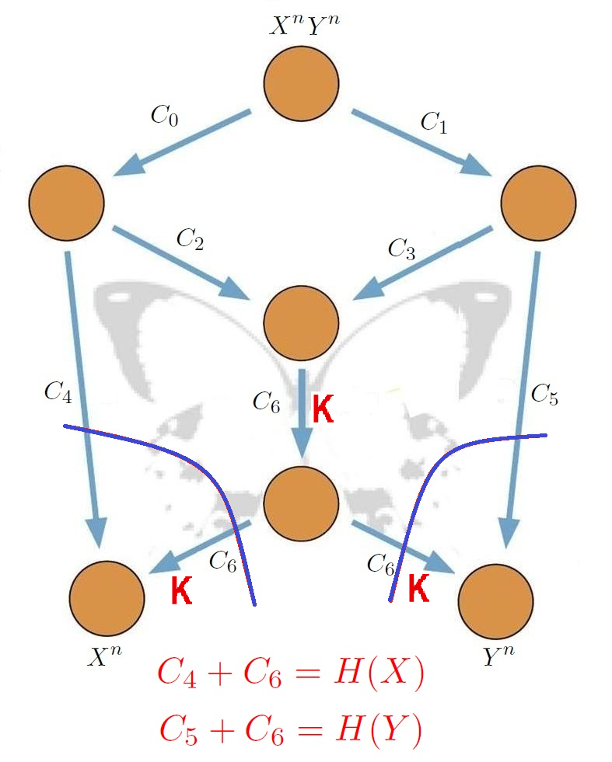
What if cuts are loose?
>
>
/27
Notes:
Insert a map of your country.

Slide 15
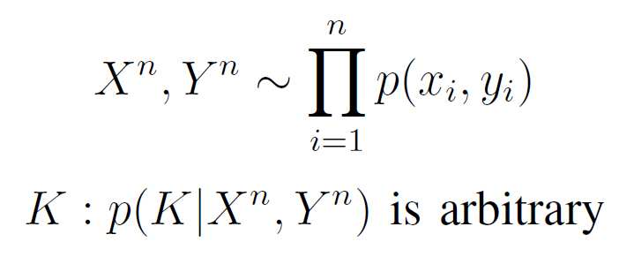
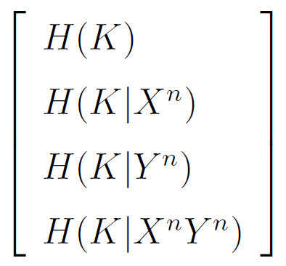
Vector of uncertainties
/27
Notes:
Insert a map of your country.

Slide 16
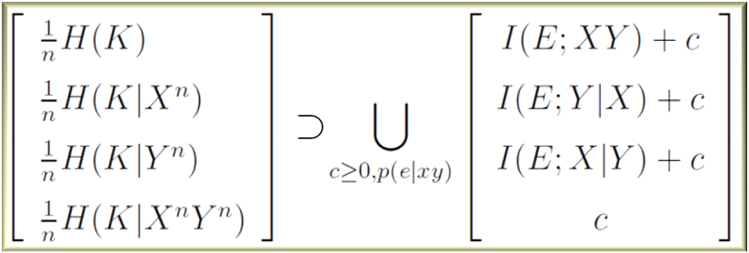
Vector of uncertainties
/27
Notes:
Insert a map of your country.

Slide 17
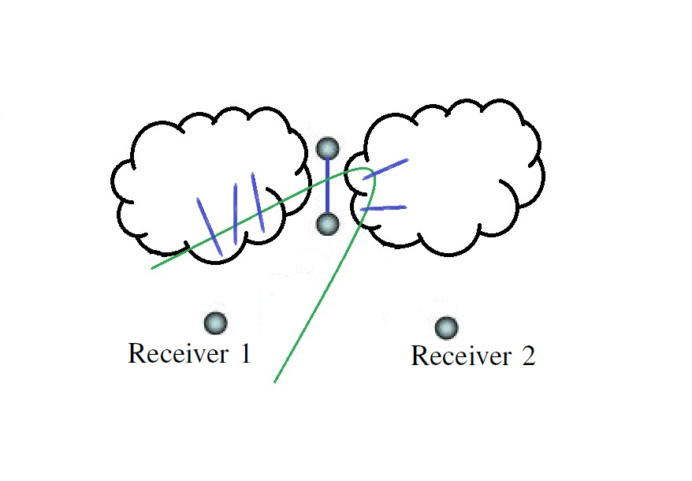
Cuts imply restrictions on the uncertainty vector
/27
Notes:
Insert a map of your country.

Slide 18
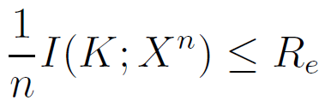
Equivocation rates imply restrictions on the uncertainty vector
/27
Notes:
Insert a map of your country.

Slide 19
Outline
A converse for Network Coding with correlated sources
General broadcast channels
Definition and Review
The best known upper bound is not tight
Capacity of new classes of broadcast channels
Other results
/27
Notes:
Insert a map of your country.

Slide 20
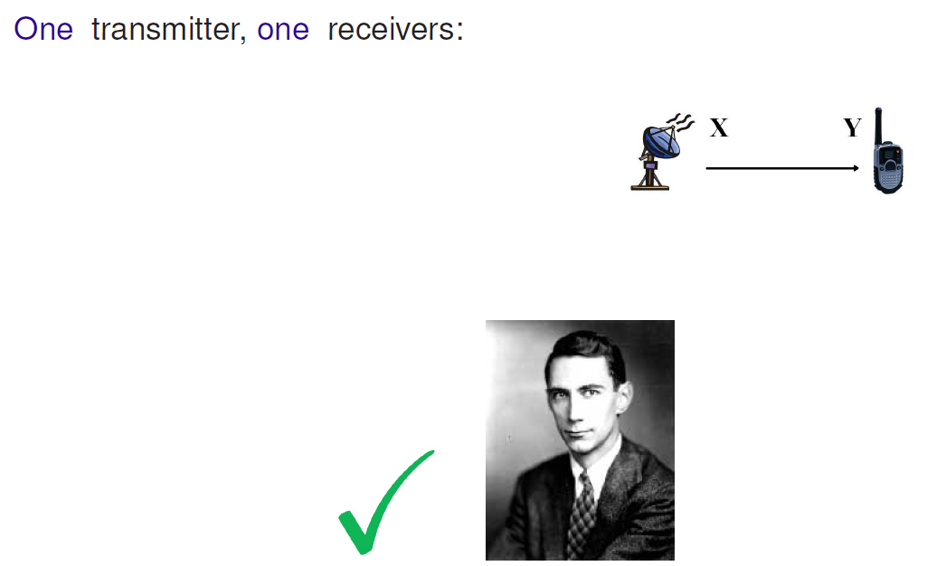
Broadcast channel
/27
Notes:
Insert a map of your country.

Slide 21
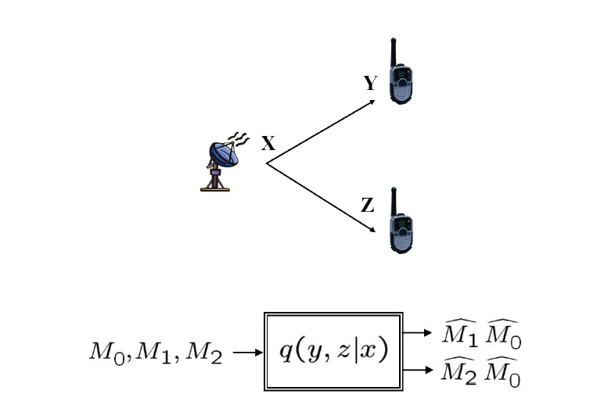
Broadcast channel
/27
Notes:
Insert a map of your country.

Slide 22
Solved Special cases
Degraded, less noisy, more capable
Deterministic, Semi-Deterministic
Reversely degraded
/27
Notes:
Insert a map of your country.

Slide 23
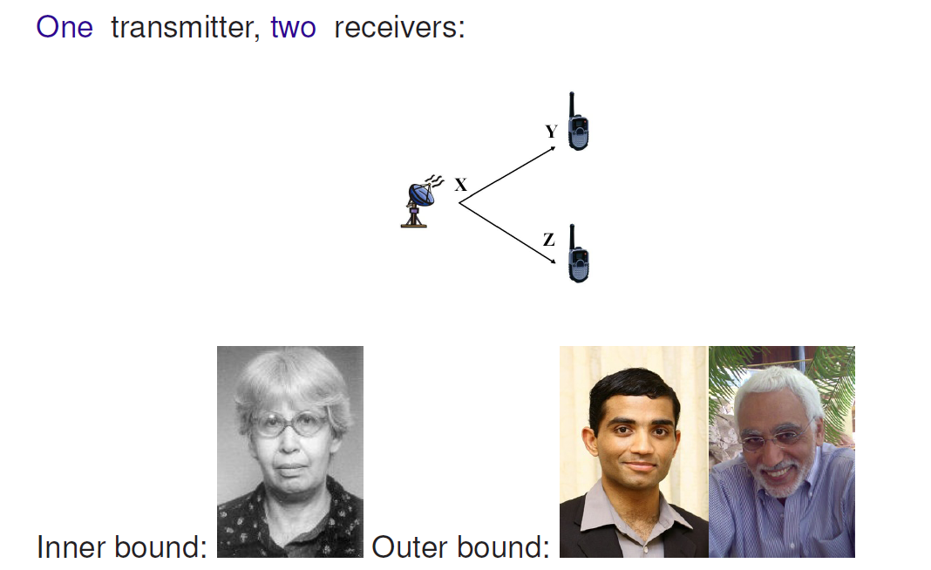
Best known Inner and Outer bound
/27
Notes:
Insert a map of your country.

Slide 24
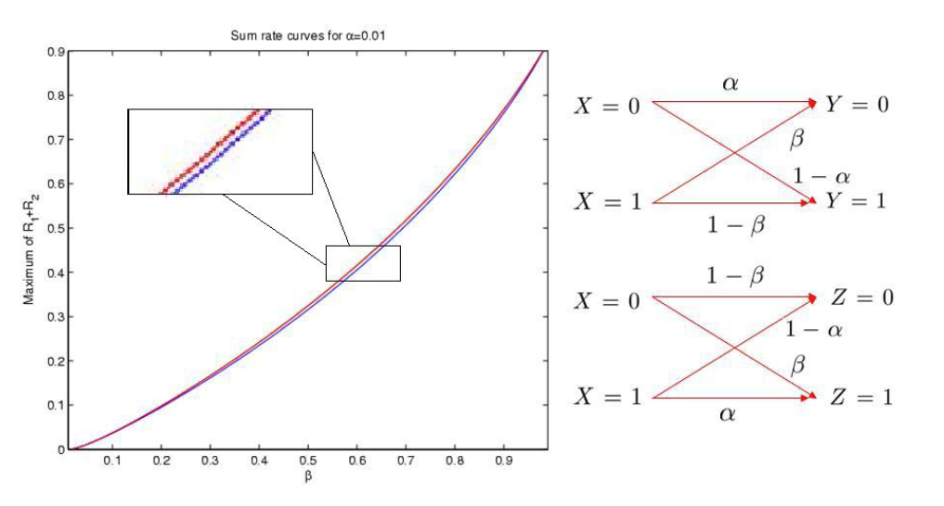
There is a gap between the outer and the inner bounds
/27
Notes:
Insert a map of your country.

Slide 25
Outline
A converse for Network Coding with correlated sources
General broadcast channels
Definition and Review
The best known upper bound is not tight
Capacity of new classes of broadcast channels
Reversely semi-deterministic channels
Other results
/27
Notes:
Insert a map of your country.

Slide 26
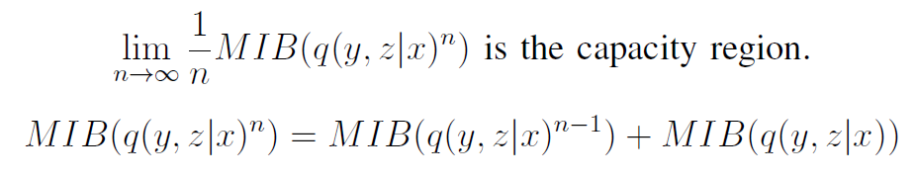
High level intuition
/27

Slide 27
Outline
A converse for Network Coding with correlated sources
General broadcast channels
Definition and Review
The best known upper bound is not tight
Capacity of new classes of broadcast channels
Other results
Conclusions
/27
Notes:
Insert a map of your country.

